Slide 1
Realised by:
BRACCHI Pierre
KABA Saran
KANDE Desse
PULLICINO Perrine
SIROUKANE Slimane
YUGANSAN Yogaratnam
Software Engineering
Project
Presentation (Group1)
Karim TEKKAL
Gustavo PETRI
Github : https://github.com/kabasaran/Favorite_Places_Management

Slide 2



An App to share your favourite places !
This app will allow you to keep track of your favorite places and your upcoming events while sharing all of that with your friends !

Slide 3
System Definition
Mark a place down as one of your favourites in the world.
Plan your upcoming events and share them with your friends.
Share your maps with your friends or make it available publicly.
Manage multiple maps, and combine them.
Add your own photos of the events and places you go to.
Find the shortest way to go where you want to go !

Slide 4



Users
There is only one type of user in this app : The regular one.
He is able to create, edit, manage and share maps.
On them, he can organise events, place points of interest and check what others have
decided to share.
He has the possibility to publish photos and messages, and to befriend others.

Slide 5
Business Objects : recap
The business objects would be :
The Users themselves.
The Places of interest a user can pinpoint.
The Events the users can schedule.
The Maps a user will create and manage.
The messages and pictures a user can send.

Slide 6
Technical Proposition
Database
Main Server
We have four main subsystems coexisting in our app :
Database stocking data of users and places/events.
The main server running the code
The Google Map API, called to display the map to the user.
The user’s own screen, on which we will render the map.
Google Map API
GUI (Mobile, User’s screen)

Slide 7
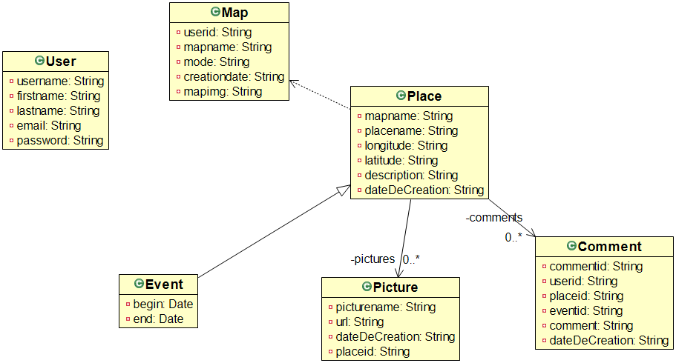
Business Objects : Diagram

Slide 8
The Database : How it works
> All our DAOs represent a Database Entity : User, Event/Place, Map,..
They share common functions extended from the DAO abstract class :
> The add function is the same for all the DAOs and allow us to push
> The delete function is not shared and takes care, for each DAO, to delete « en cascade » the appropriate data in linked tables.
> The find function is explicit and returns the row of the found row.
> The exist function allows for the real checks to take place
(For example, we check in it that the end date of an event isn’t already over)

Slide 9

GOALS IN MIND
Efficiency
Design
Easy handling
Simplicity

Slide 10
Navigation Diagram
Login
disconnect
Map View
Add Place/Event
View Place/Event
List Map
Edit Place/Event
Add Map
Edit Map

Slide 11
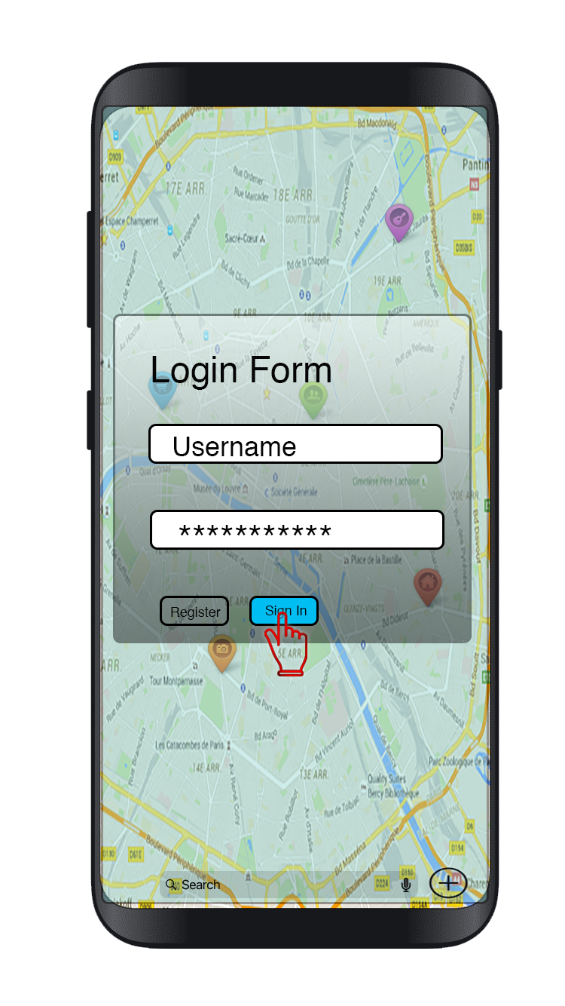
Navigation Diagram
Login
disconnect
Map View
Add Place/Event
View Place/Event
List Map
Edit Place/Event
Add Map
Edit Map
This would be your home page.

Slide 12
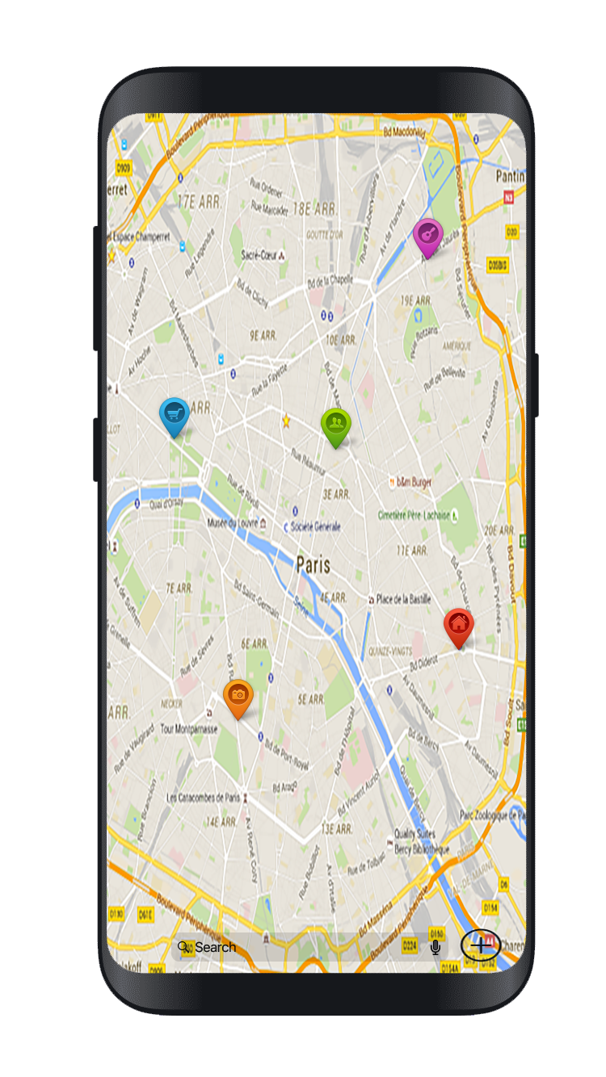
Navigation Diagram
Login
disconnect
Map View
Add Place/Event
View Place/Event
List Map
Edit Place/Event
Add Map
Edit Map
The idea is that as soon as you arrive on the homepage,
you can see the relevant information you might need.

Slide 13
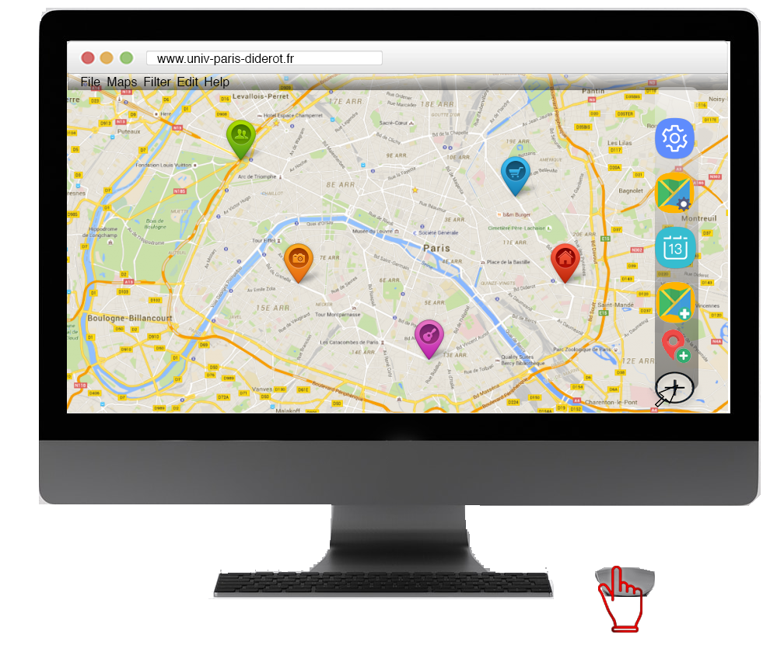
Navigation Diagram
Login
disconnect
Map View
Add Place/Event
View Place/Event
List Map
Edit Place/Event
Add Map
Edit Map
In this case, it would be streets around you and thus
the potential interest points you or other people may have, could be marked down

Slide 14
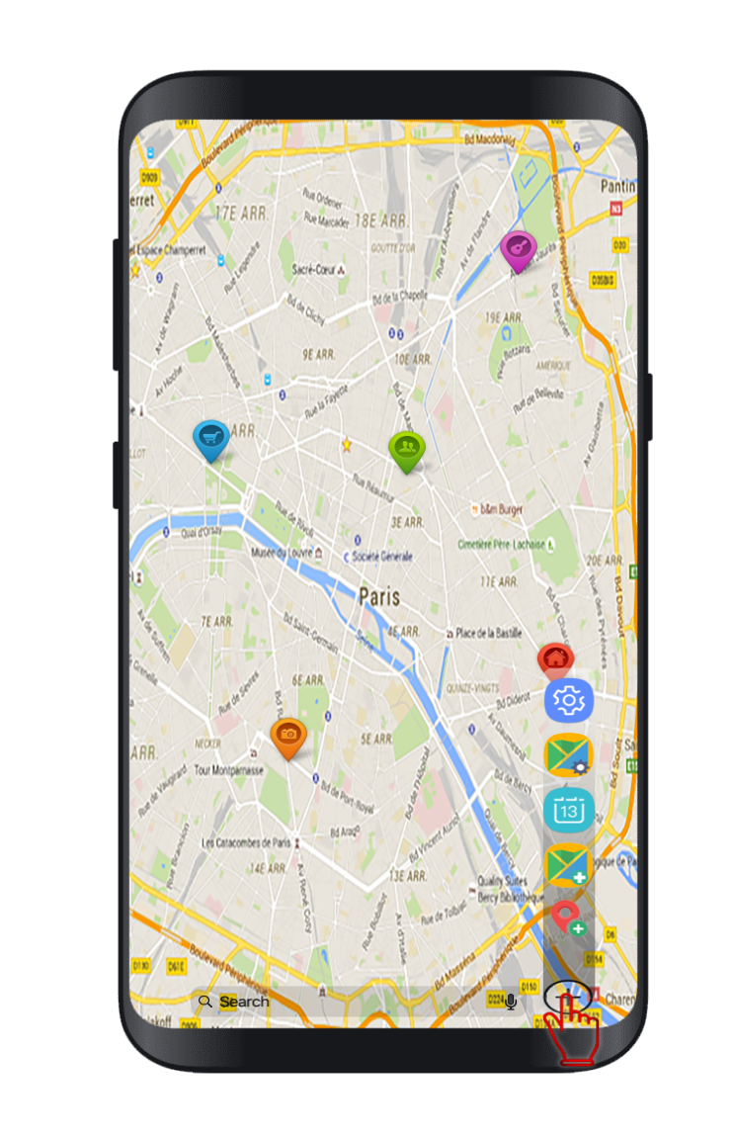
Navigation Diagram
This would be the main way of using our application :
Login
disconnect
Clicking on the cross sign would open a pop-up menu that would allow the user to select what he wants to do with the app.
Map View
Add Place/Event
View Place/Event
List Map
Edit Place/Event
Add Map
Edit Map
This seems to us to be the best way to provide maximum efficiency for the user.

Slide 15
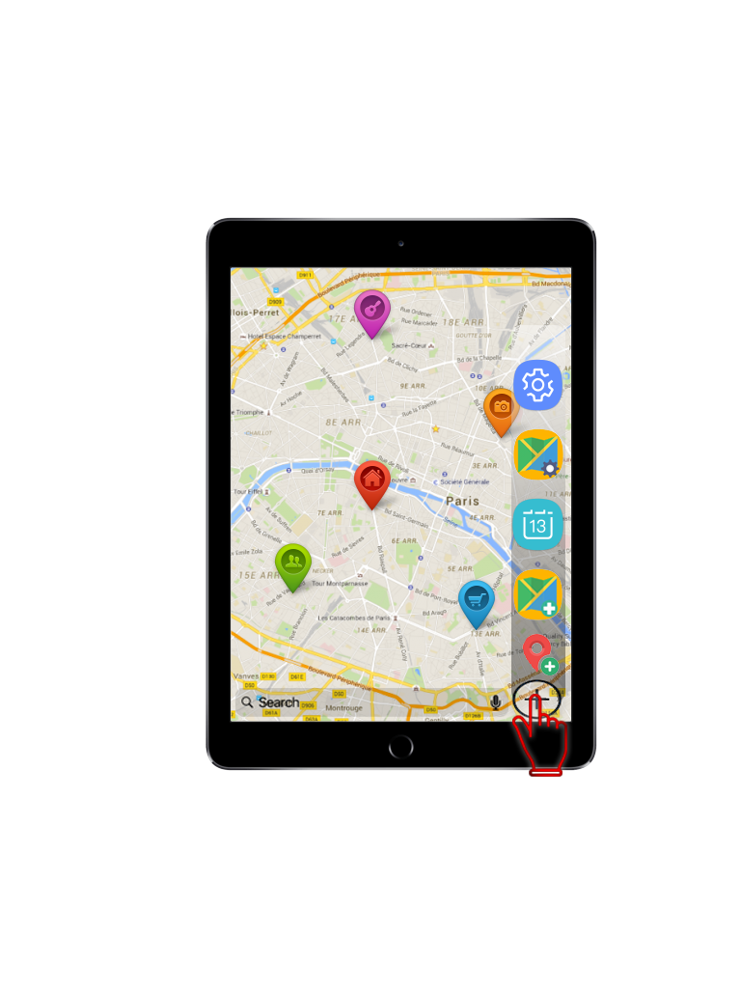
Navigation Diagram
Login
disconnect
Map View
Add Place/Event
View Place/Event
List Map
Edit Place/Event
Add Map
Edit Map
This is mainly the same idea as the previous mock-up, but the interface would have to be revamped to better fit a tablet.

Slide 16
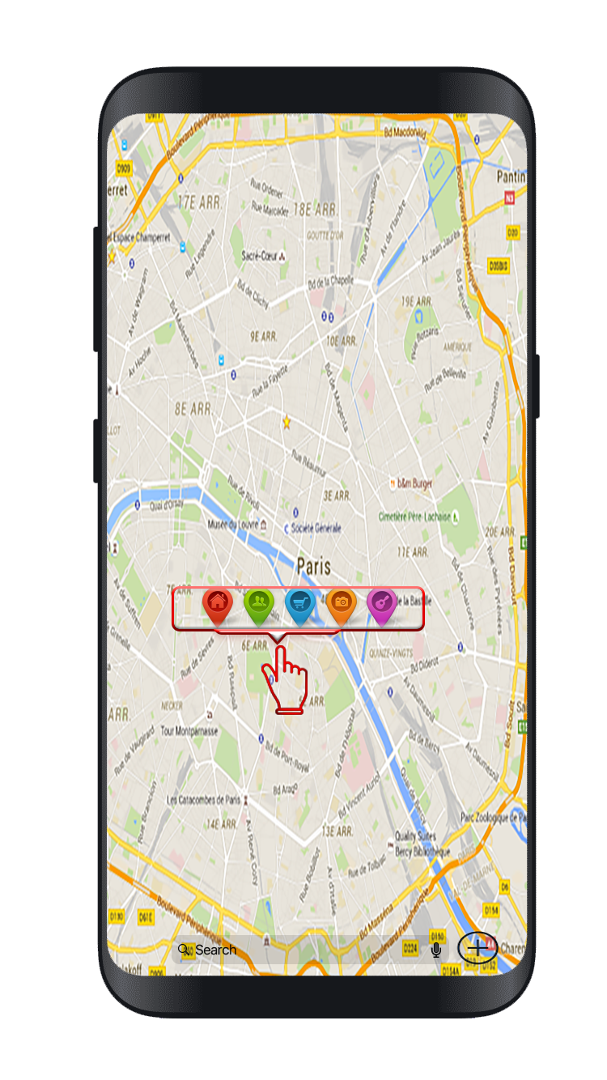
Navigation Diagram
Login
disconnect
Map View
Add Place/Event
View Place/Event
List Map
Edit Place/Event
Add Map
Edit Map
User can add places/event by selecting on menu bar.
Or by pressing on a specific place, a pop-up can be opened…

Slide 17
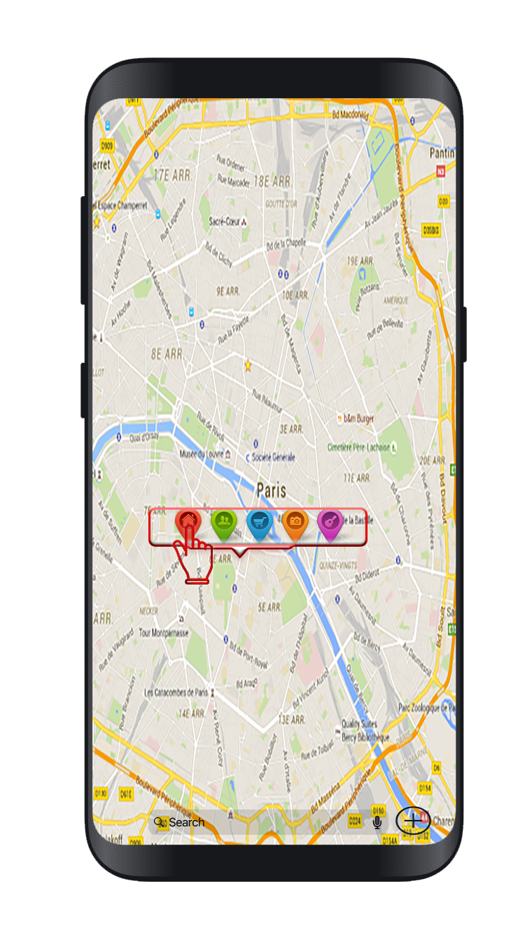
Navigation Diagram
Login
disconnect
Map View
Add Place/Event
View Place/Event
List Map
Edit Place/Event
Add Map
Edit Map
that would allow the user to select whether he wants to add features like places, events...

Slide 18
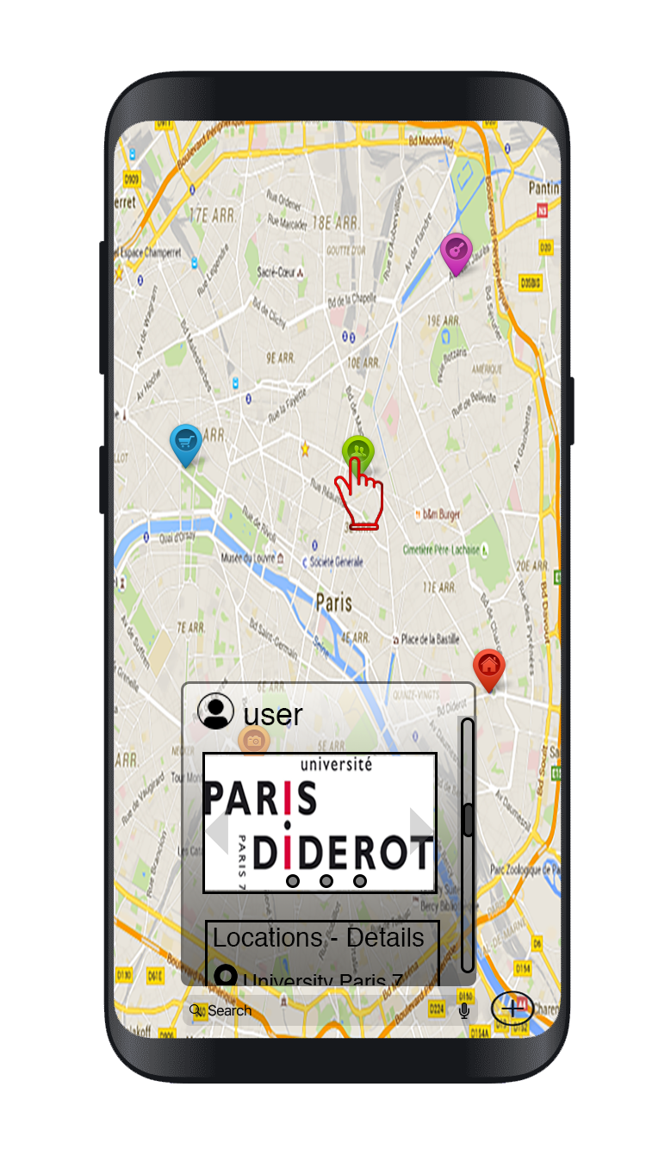
Navigation Diagram
Login
disconnect
Map View
Add Place/Event
View Place/Event
List Map
Edit Place/Event
Add Map
Edit Map
By touching icon on map, we can get access to more information about…

Slide 19
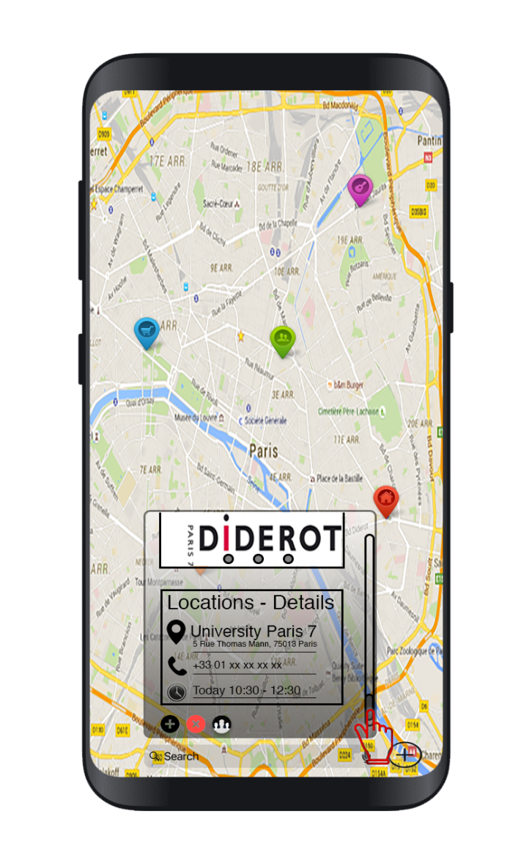
Navigation Diagram
Login
disconnect
Map View
Add Place/Event
View Place/Event
List Map
Edit Place/Event
Add Map
Edit Map
photos shared, information about events, description of place/event,…

Slide 20
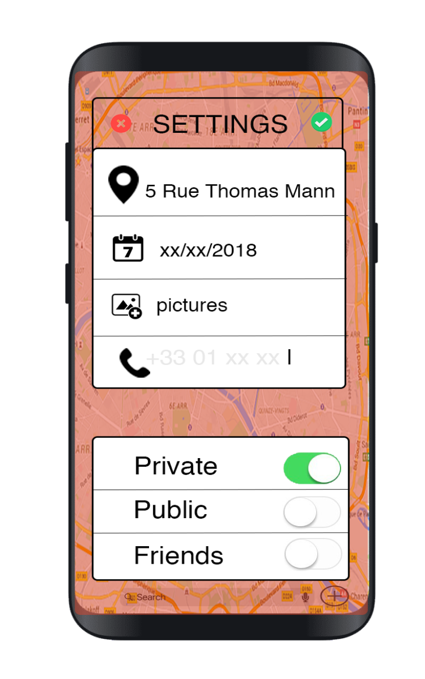
Navigation Diagram
It would be the adding/setting
menu for place/event.
Login
disconnect
Map View
If the user adds by the menu bar, he can write
the address and fill up other information.
Add Place/Event
View Place/Event
List Map
Edit Place/Event
Add Map
Edit Map
If its by the pop-up, address will auto completed and he can fill up the rest of information. He can also decide to share it.

Slide 21
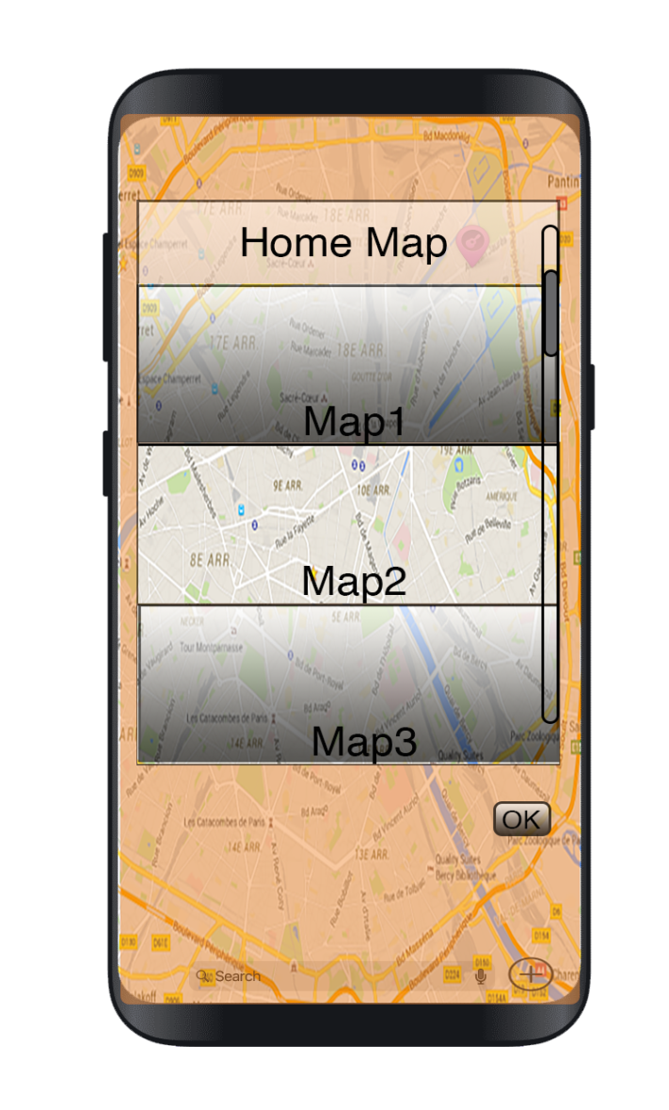
Navigation Diagram
Login
disconnect
Map View
Add Place/Event
View Place/Event
List Map
Edit Place/Event
Add Map
Edit Map
List of maps the user created.
He can select the maps he want to activate on the general plan, add or delete.

Slide 22
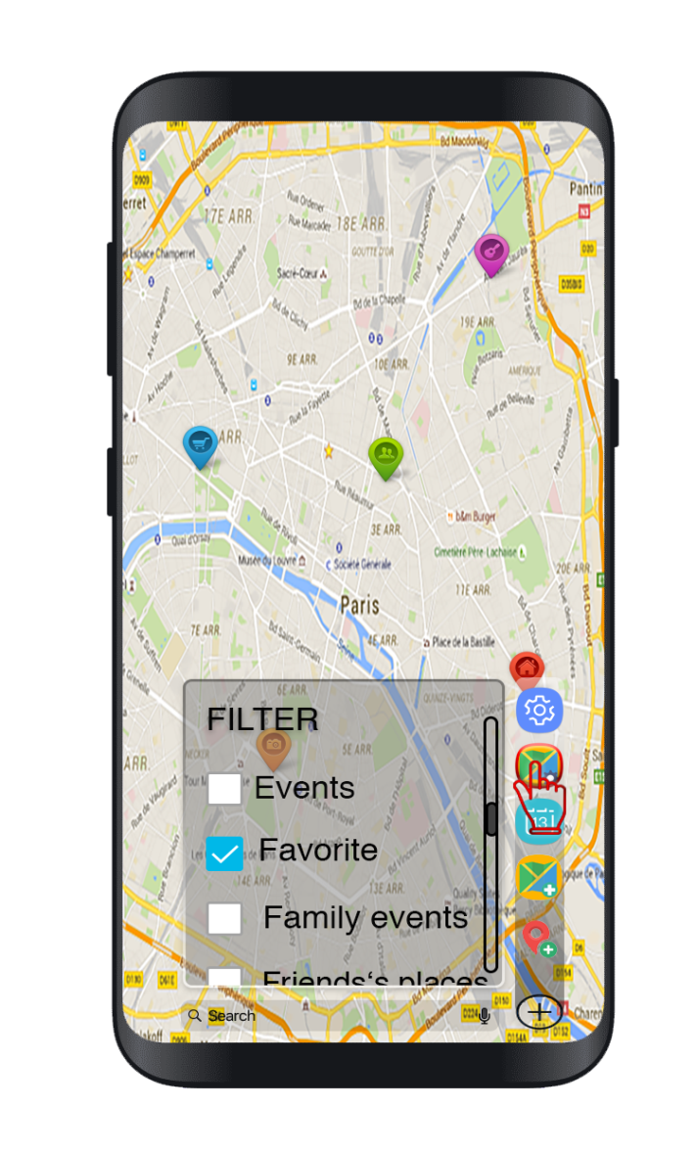
Navigation Diagram
Login
disconnect
Map View
Add Place/Event
View Place/Event
List Map
Edit Place/Event
Add Map
Edit Map
A quick-access to the filters of the current map.

Slide 23
Backlog
To do | Priority | Difficulty
Manage place, events : Add, delete or edit them. | 5 | 3
Manage multiple maps : Add, delete, edit, share them. | 4 | 4-5
Filter by category : You can select a category to display on your map. | 4 | 5
Login/Logout protocol. | 3 | 2
Friendlist :Add a friend, delete a friend, share with them. | 3 | 1
Pictures : Add, delete, comment, share. | 3 | 3
Messages/Comments : Add, delete, edit, share. | 3 | 3
Pathfinding : Find the shortest path between two points. | 2 | 2
Search for a map (from friend or a public one) | 2 | 2
Search for a place (by name or by coordinates) | 2 | 2
Notes:
<numéro>

Slide 24
Web Services
Type | URL | Behavior
GET | /list | Returns a list of maps
GET | /{id_map}/{id_place} | Returns detail of a place / event for the corresponding «id»
GET | /{id_map} | Returns detail of a map for the corresponding «id»
POST | /{id_map}/{id_place} | Modify a place / event for the corresponding «id»
POST | /{id_map} | Modify a map for the corresponding «id»
PUT | / | Add a new map
PUT | /{id_map}/ | Add a new place / event
DELETE | /{id_map} | Delete a map
DELETE | /{id_map}/{id_place} | Delete a place / event
PUT | /{id_map}/{id_place} | Add a picture to an event or place
DELETE | /{id_map}/{id_place}/{id_picture} | Delete a picture
Notes:
<numéro>

